Slide 1
Natalie Cheng Michelle Chen
Zi Jun Jiang
Project Proposal
SK!N STAY INFORMED ABOUT YOUR SKIN

Slide 2
APP CONCEPT & PURPOSE
SK!N checks ingredients in skincare and makeup products and recommends products and routines for skin types and concerns
It aims to help users be more informed about skincare and makeup products for cleaner and healthier skin

Slide 3
FEATURES
Scan or search products and the ingredients will be analyzed to be on a scale of harmful to beneficial for the skin
Upload current skincare routine and receive feedback from other users
Start following skincare or makeup routines through tutorials posted by other users
SCAN & SEARCH
UPLOAD ROUTINE
USER INTERACTION

Slide 4
DATABASE/API
SENSORS
Google Firebase
SkincareAPI: Provides users with a catalog of products with brand, name, and ingredients
Makeup API: Search makeup products UPCItemDB: Searches products by barcode and product name
Camera
Scans a product’s barcode
Users can record videos and take pictures

Slide 5
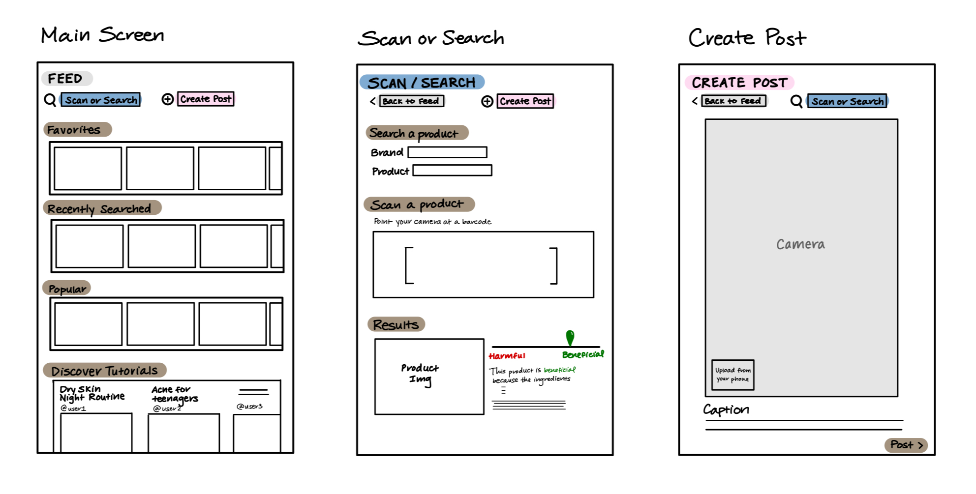
Device Types
Phone & Tablet

